Slide 1
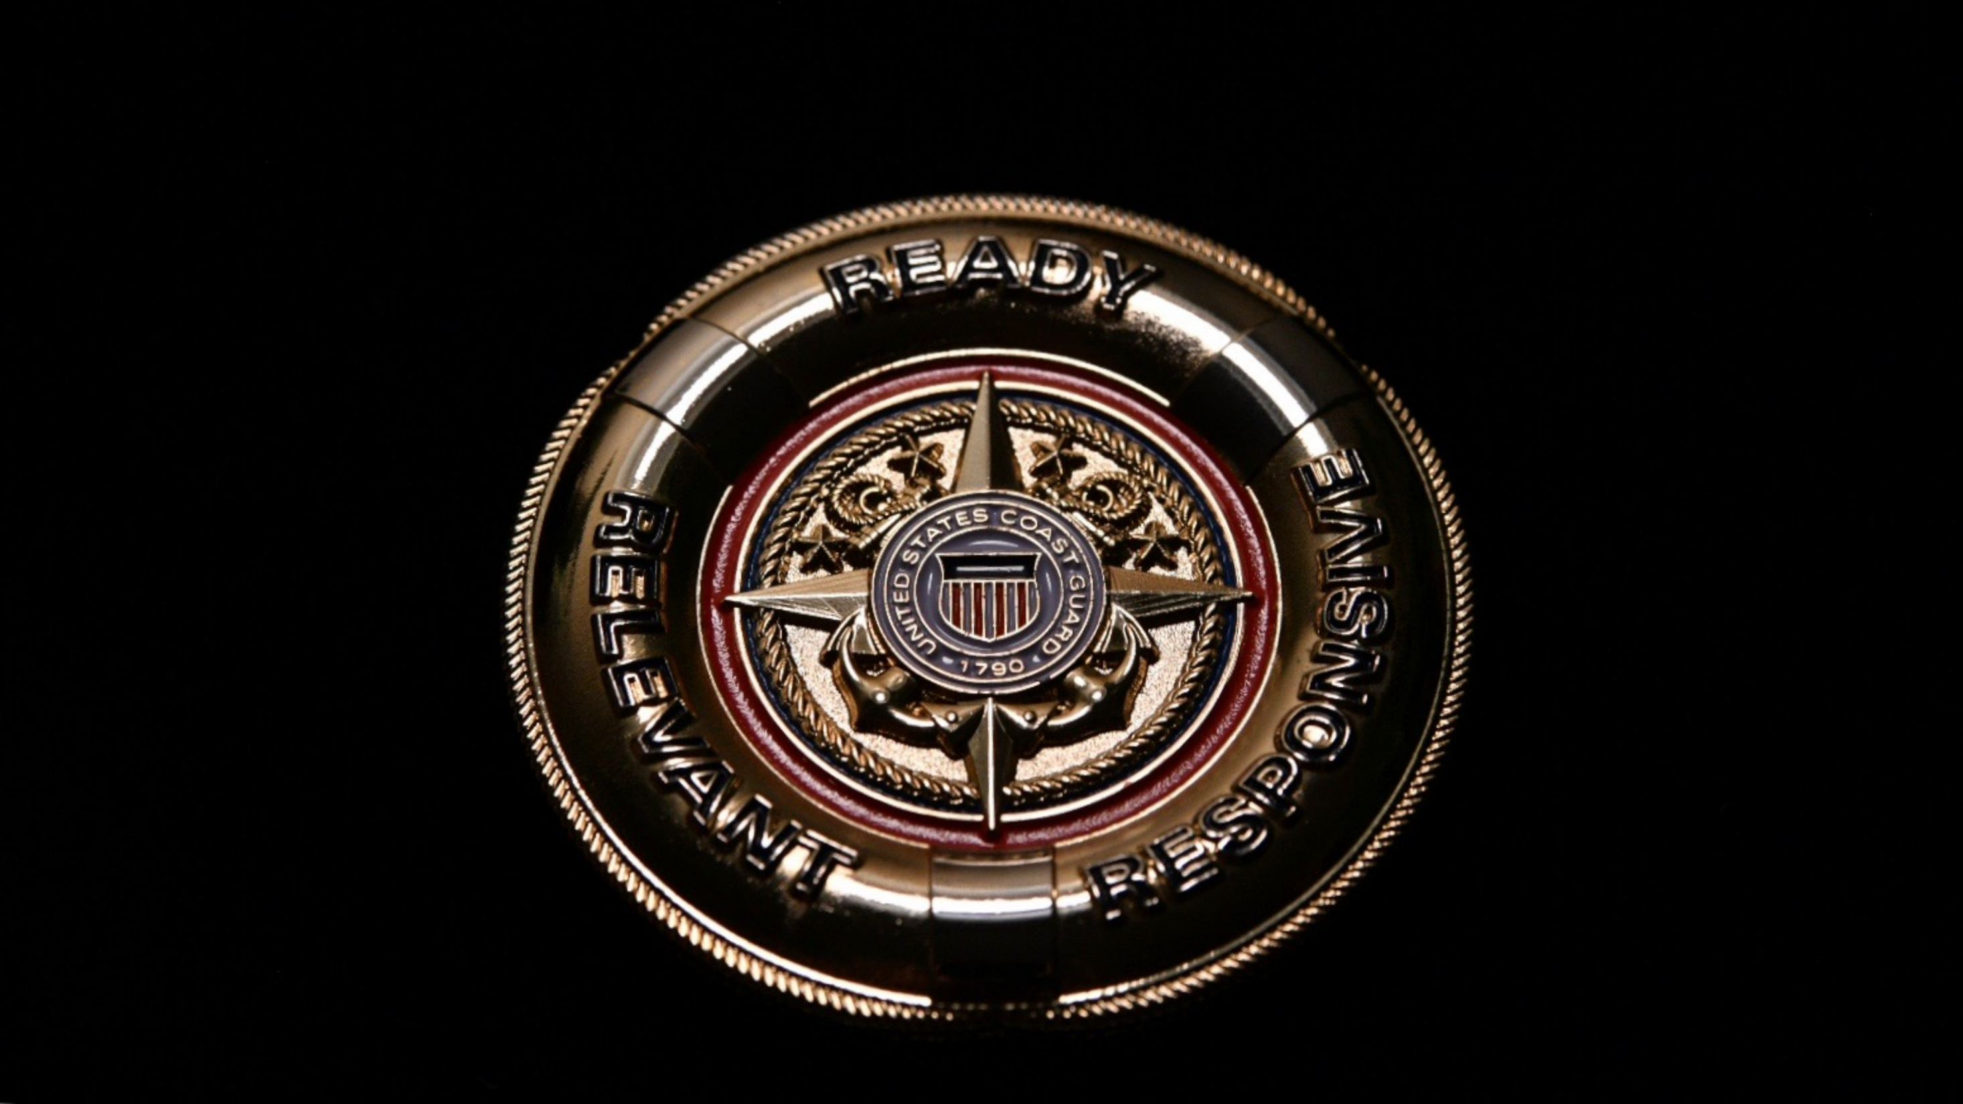
USCG National Retiree Council
September 2021

Slide 2
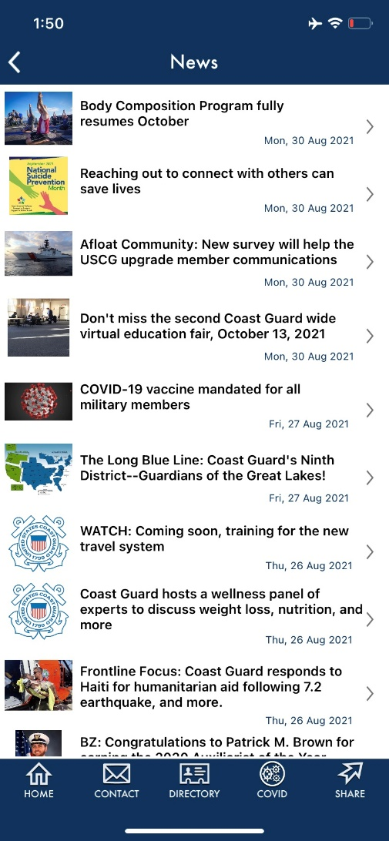
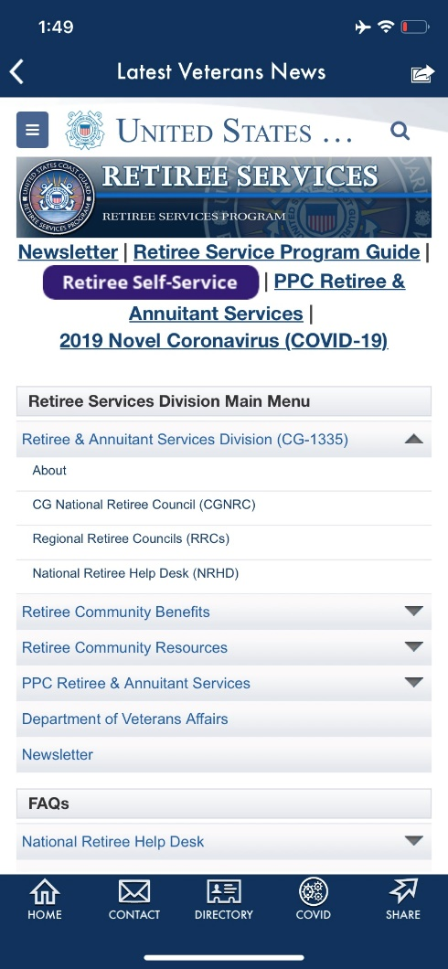
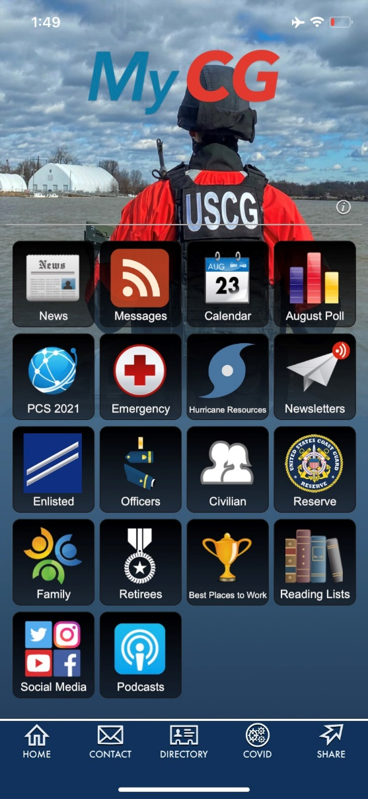
MyCG

Slide 3
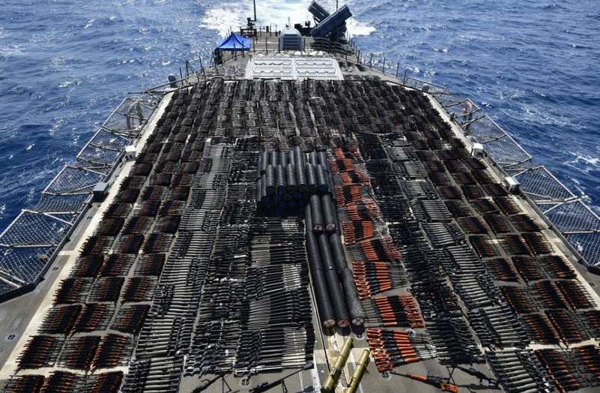
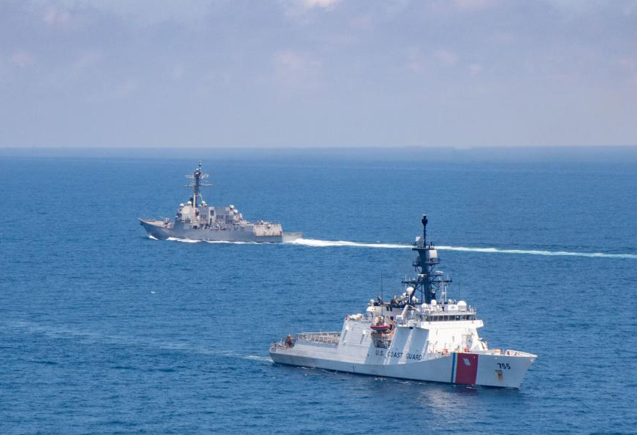
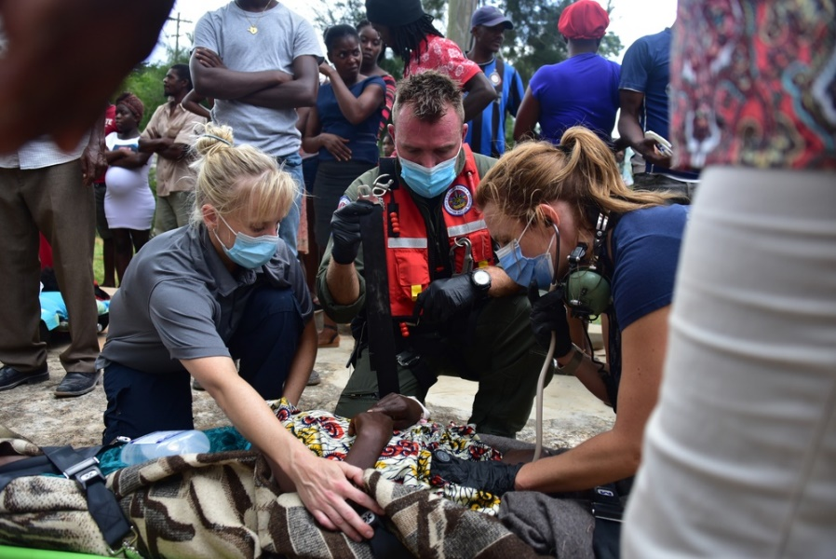
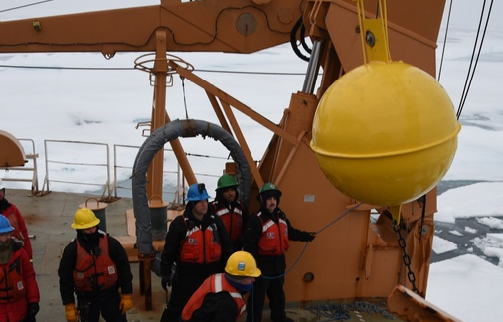
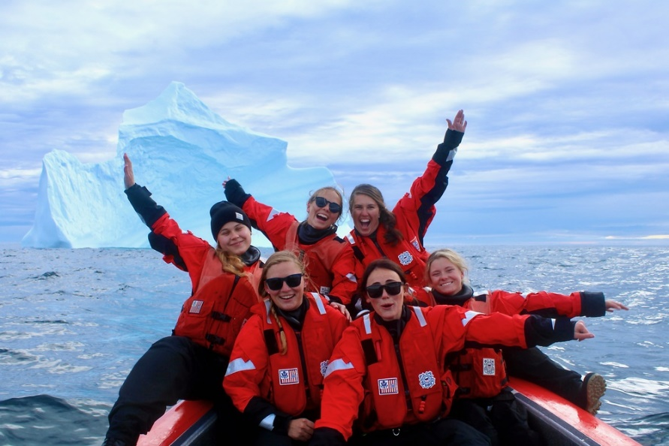
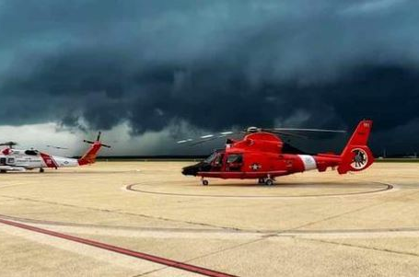
Coast Guard AIT work in 5th Fleet USCGC MUNRO with USS Kidd in Taiwan Strait Coast Guard First Responders in Haiti
USCGC HEALY Deployment USCGC RICHARD SNYDER in Labrador Sea District 8 responds to Hurricane Ida
FEBRUARY 2019

